Slide 1


Multichannel high speed camera with 10 GbE interface
Master Thesis
Supervisor: PhD Grzegorz Kasprowicz
Author: Piotr Zdunek
Photonics and Web Engineering Group, Institute of Electronic Systems, Warsaw University of Technology

Slide 2
Agenda
Introduction
System overview
Multichannel operation
Zynq SoC
Data acquisition
10 GbE
Project’s schedule

Slide 3
Introduction
There is a need for a multiple sensor camera – in a form of a strip
Real time operation
Scalable
Easy to maintain
Supporting high speed interfaces (10 GbE)

Slide 4
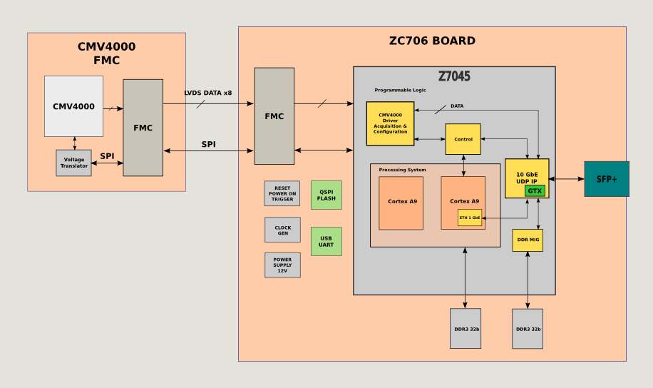
System overview

Slide 5
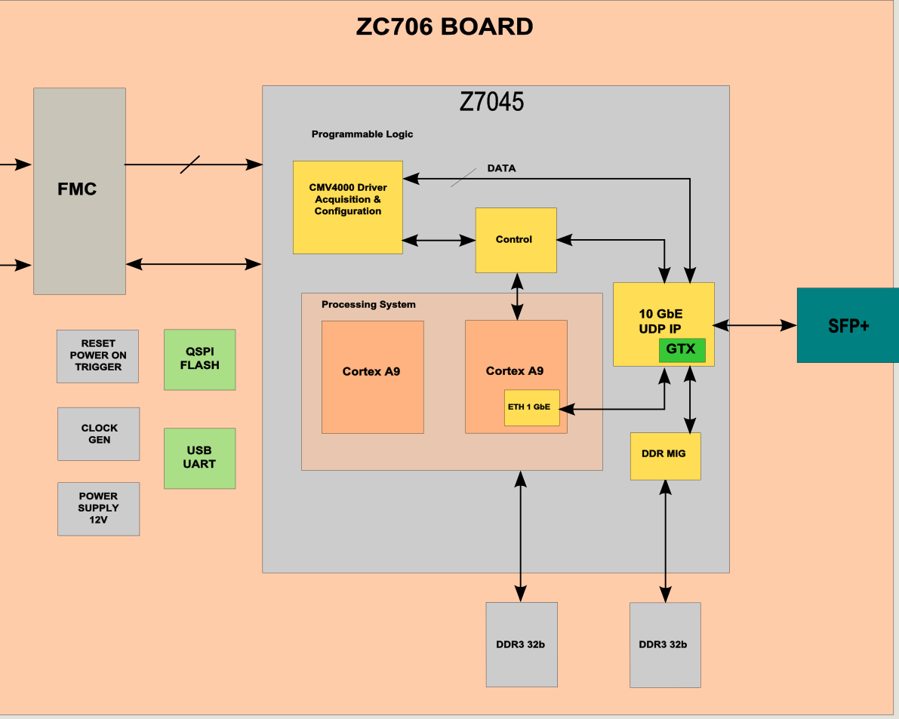
System overview

Slide 6
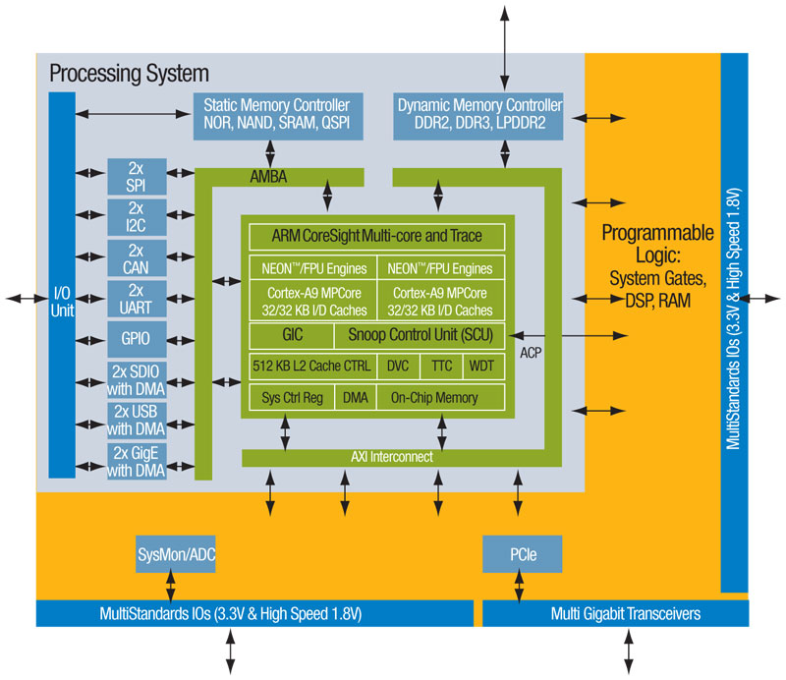
Xilinx Zynq
2x Cortex A9
Lots of peripherials
Kintex FPGA
High throughput interconnect

Slide 7
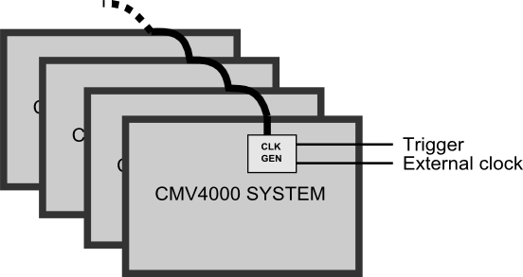
Multichannel operation
External or internal clock signal
External trigger
Synchronised frame acquisition with timestamp (IEEE1588)

Slide 8
Data acquisition
CMV4000 generates 4MP of data per frame over 16 LVDS lines
Maximum 180 fps
Maximum sensor clock is 480 MHz
180*4MP*10bit = 7200 Mbps

Slide 9
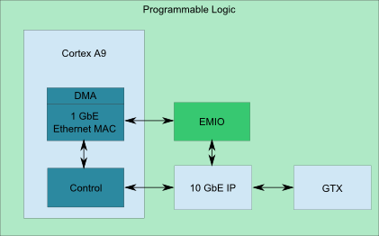
10 GbE UDP IP
Stream data through Ethernet using UDP
Get rid of PHY – use GTX
Cheaper solution
Create custom GbE UDP IP
Which would incorporate hardware MAC in Zynq
EMIO – Extended Multiplexed Input Output

Slide 10

Project’s schedule
Learn how to use Zynq and Vivado/PlanAhead
Sensor driver (IP Core) in programmable logic – end of June
Sensor control in Cortex A9 using FreeRTOS – end of July
Sensor data streaming through built in Ethernet MAC – end of September
Multichannel data acquisition synchronisation – end of October
Develop 10 GbE UDP IP core – end of year
Tests – till Feburary

Slide 11
Thank you for your attention
Piotr Zdunek

